Slide 1
Introduction to Programming Language (Java)
Fariha Zahin
Lecturer
CSE, Southeast University

Slide 2
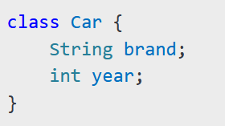
What is a Class?
A class is a blueprint for creating objects.
It defines attributes (variables) and behaviors (methods).
Example:

Slide 3

What is an Object?
An object is an instance of a class.
It holds actual values and can invoke methods.
Example:

Slide 4
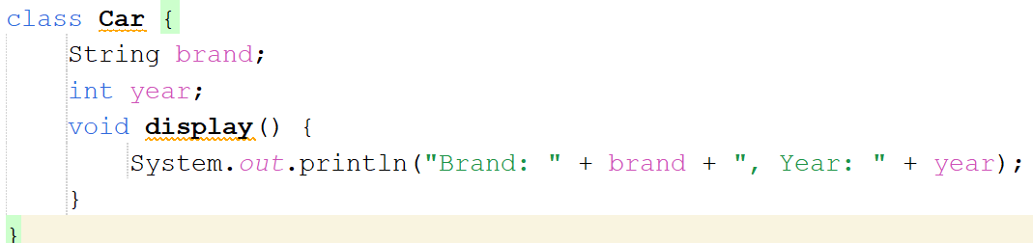
Creating a Class in Java
Define a class with attributes and methods.
Example:

Slide 5
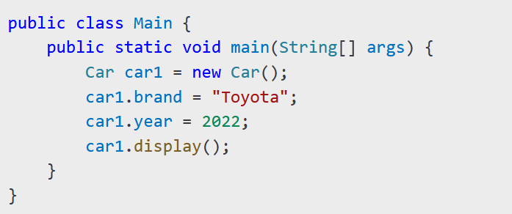
Creating Objects in Java
1.Instantiate a class using the new keyword..
Understanding the new keyword:
The new keyword dynamically allocates memory for an object.
It returns a reference to the newly created object.
Steps involved:
Memory allocation for the object.
Constructor invocation to initialize the object.
Reference assignment to the object.

Slide 6
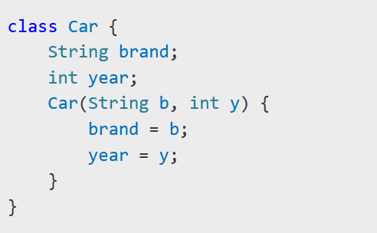
2.Using Constructors
A constructor initializes objects.
Properties of a Constructor in Java
1.Same Name as Class
A constructor must have the same name as the class.
No Return Type
A constructor does not have a return type, not even void
Automatically Called
It is automatically invoked when an object of the class is created.
Can Be Overloaded
Multiple constructors can be defined with different parameters (Constructor Overloading).
Cannot Be Inherited
Constructors are not inherited by subclasses, but a subclass can call the parent class constructor using super keyword.

Slide 7
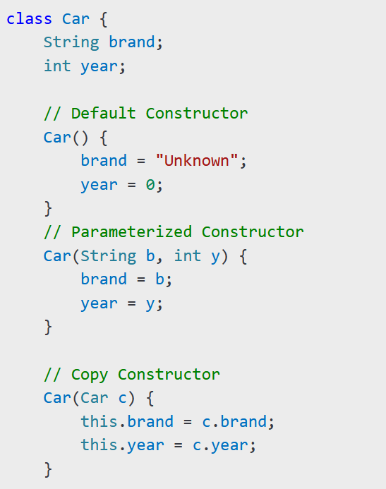
Types of Constructors:
Default Constructor - No parameters, initializes default values.
Parameterized Constructor - Takes arguments to initialize object properties.
Copy Constructor - Creates a new object by copying another object's values.

Slide 8
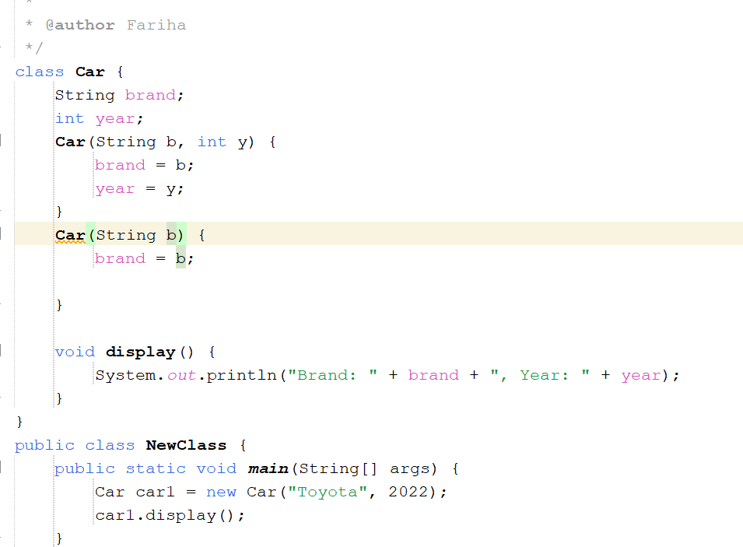
Constructor Overloading in Java
Definition: Constructor overloading in Java allows a class to have multiple constructors with different parameter lists. The appropriate constructor is selected based on the arguments passed during object creation.

Slide 9
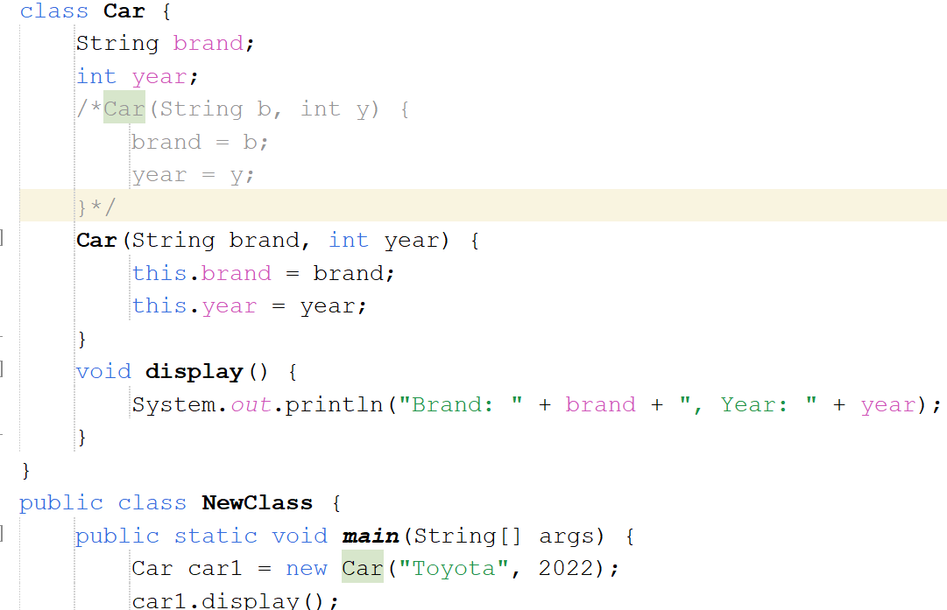
Use of this keyword:
this keyword in Java refers to the current object of the class. It is used to refer to the current object's instance variables, methods, and constructors.
It is commonly used in constructors to distinguish between instance variables and parameters when they have the same name.

Slide 10
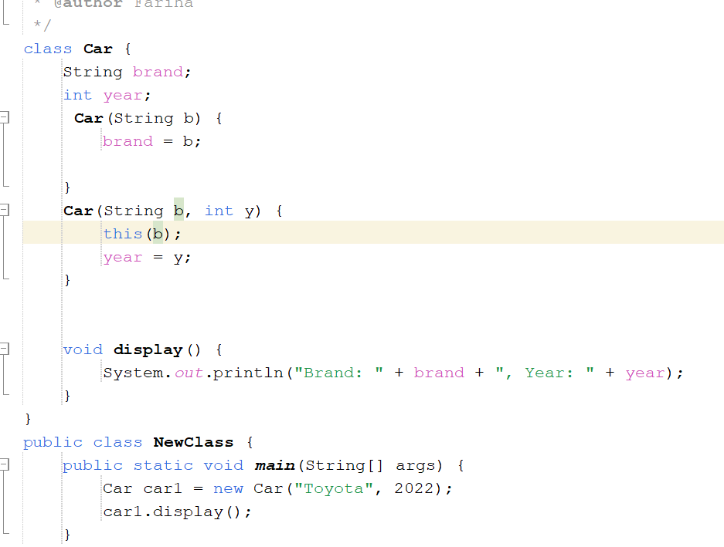
this() must be the first statement in a constructor.
Helps in constructor chaining within the same class.
Constructor chaining is the process of calling one constructor from another constructor within the same class or from a parent class using this(). It helps reduce code duplication and improves reusability.

Slide 11
